Slide 1
Bearing Fault Problem
ANN Application
Wijaya, I Gede Pasek Suta

Slide 2
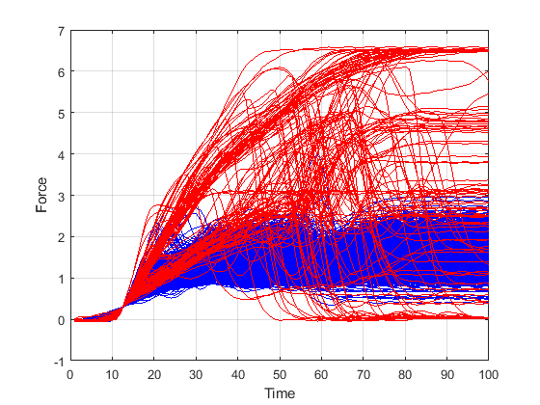
Introduction
Suppose given data of bearing fault problem:
Blue: representing good (OK) while Red representing bad (Not OK)
Data size of Good vs Bad : 1864 vs 136)

Slide 3
How to classify
Standardize inputs to zero mean, variance one by using “mapstd function”
The mapstd function is to process matrices by mapping each row’s means to 0 and deviations to 1
Example :
X1 =
0.9593 0.8407 0.3500
0.5472 0.2543 0.1966
0.1386 0.8143 0.2511
0.1493 0.2435 0.6160
0.2575 0.9293 0.4733
y1 =
0.7511 0.3840 -1.1351
1.1410 -0.4171 -0.7239
-0.7257 1.1407 -0.4150
-0.7576 -0.3758 1.1335
-0.8626 1.0961 -0.2335
mapstd
mean = muX1 stdX1 muy1 stdy1
0.7167 0.3230 -0.0000 1.0000
0.3327 0.1880 0.0000 1.0000
0.4013 0.3620 0.0000 1.0000
0.3363 0.2468 -0.0000 1.0000
0.5534 0.3430 0.0000 1.0000

Slide 4
…Next…
Apply Principal Compoments Analysis for features extraction (“processpca” matlab function)
processpca processes matrices using PCA so that each row is uncorrelated, the rows are in the order of the amount they contribute to total variation, and rows whose contribution to total variation are less than maxfrac are removed.
Here we apply:
FP.maxfrac = 0.1;
[ptrans,ps2] = processpca(pn, FP);

Slide 5
…Next…
Select two principle components called as pca1 and pca2 the plotted as follows:
fPca = ptrans';
plot(fPca(:,1), fPca(:,2),'.') % OK
Non linear separable

Slide 6
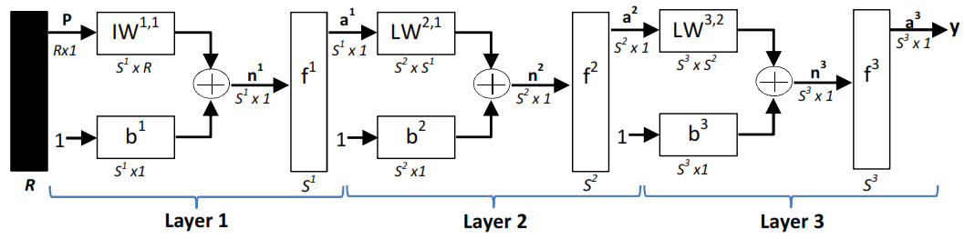
ANN for classification
ANN Model:
Find out:
The best activation function
Number of hidden layer
etc

Slide 7
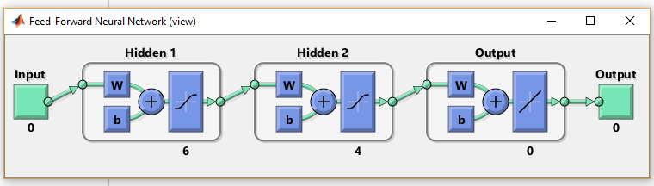
Design ANN
Binary coding 0/1 the target
target = double(target > 1);
create a neural network
net = feedforwardnet([6 4]);
set ANN parameters
net.divideParam.trainRatio = 0.70;
net.divideParam.valRatio = 0.15;
net.divideParam.testRatio = 0.15;
view(net)

Slide 8
Training
train a neural network
[net,tr,Y,E] = train(net, fPca',target');
View the performance

Slide 9
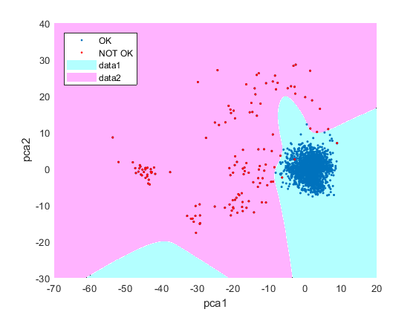
Classification line of trained ANN

Slide 10
Classification
Perform classification of train “fPca”
[Y,E] = sim(net, fPca ');
Defining the threshold = 0.5;
Y = double(Y > threshold)';
find percentage of correct classifications
acc = 100*length(find(Y==target))/length(target);
fprintf('Correct classifications: %.1f [%%]\n', cc)
Correct classifications: 99.8 [%]

Slide 11
Without PCA (left) vs PCA(right)

Slide 12
Without PCA (left) vs PCA(right)

Slide 13
Thank You
for your listening
Q & A

